Slide 1


ANALYZING THE IMPACT OF CAR FEATURES ON PRICE AND PROFITABILITY
SUBMITTED BY: SRUTHI SURESH

Slide 2
CONTENTS
Project Description
Approach
Tech-stack used
Dataset Description
Data Understanding
Data cleaning
Task analysis
Dashboard tasks
Dashboard
Result

Slide 3
PROJECT DESCRIPTION
The automotive industry has been rapidly evolving over the past few decades, with a growing focus on fuel efficiency, environmental sustainability, and technological innovation.
As a Data Analyst, we have to find solution for ‘How can a car manufacturer optimize pricing and product development decisions to maximize profitability while meeting consumer demand?’

Slide 4
PROJECT DESCRIPTION
This problem could be approached by analyzing the relationship between a car's features, market category, and pricing, and identifying which features and categories are most popular among consumers and most profitable for the manufacturer.
By using data analysis techniques such as regression analysis and market segmentation, the manufacturer could develop a pricing strategy that balances consumer demand with profitability, and identify which product features to focus on in future product development efforts.

Slide 5
APPROACH
DATA COLLECTION
DATA UNDERSTANDING
DATA CLEANING
DATA VISUALIZATION
DATA ANALYSIS
DATA PREPARATION
DATA PRESENTATION

Slide 6


TECH-STACK USED
MICROSOFT EXCEL
MICROSOFT POWERPOINT
Data Cleaning
Data Analysis
Data Visualization
Data Presentation

Slide 7
DATASET DESCRIPTION
The dataset contains information on various car models and their specifications, and is titled “Car Features and MSRP’’.
Number of observations: 11,914
Number of variables: 16
File type: CSV (Comma Separated Values)

Slide 8
DATASET DESCRIPTION
The variables in the dataset are:
Make: the make or brand of the car
Model: the specific model of the car
Year: the year the car was released
Engine Fuel Type: the type of fuel used by the car (gasoline, diesel, etc.)
Engine HP: the horsepower of the car's engine
Engine Cylinders: the number of cylinders in the car's engine
Transmission Type: the type of transmission (automatic or manual)
Driven_Wheels: the type of wheels driven by the car (front, rear, all)

Slide 9
Number of Doors: the number of doors the car has
Market Category: the market category the car belongs to (Luxury, Performance, etc.)
Vehicle Size: the size of the car
Vehicle Style: the style of the car (Sedan, Coupe, etc.)
Highway MPG: the estimated miles per gallon the car gets on the highway
City MPG: the estimated miles per gallon the car gets in the city
Popularity: a ranking of the popularity of the car (based on the number of times it has been viewed on Edmunds.com)
MSRP: the manufacturer's suggested retail price of the car

Slide 10
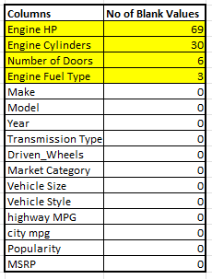
DATA UNDERSTANDING
Out of 16 columns the dataset contained, 4 columns had blank / null values.
Regarding the Duplicate records, there were 715 records which were detected as duplicates.

Slide 11
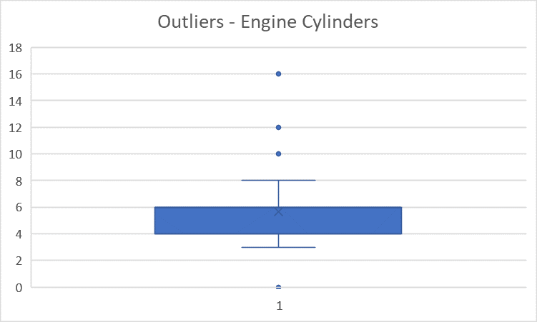
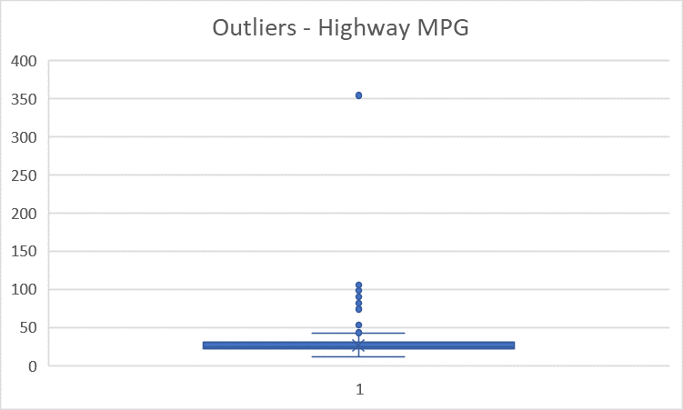
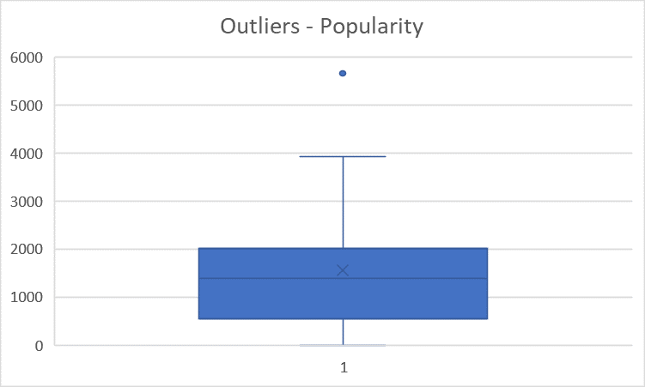
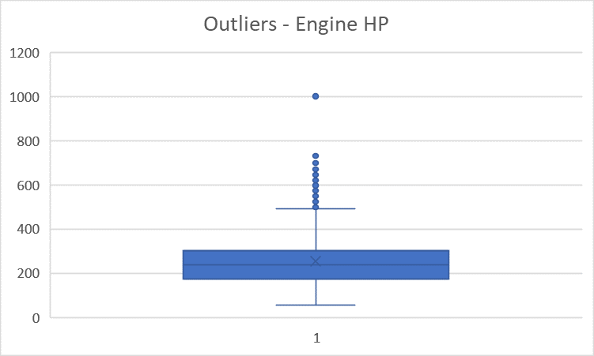
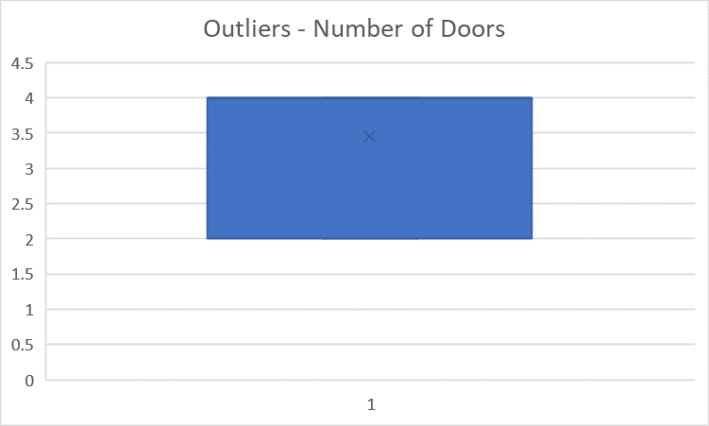
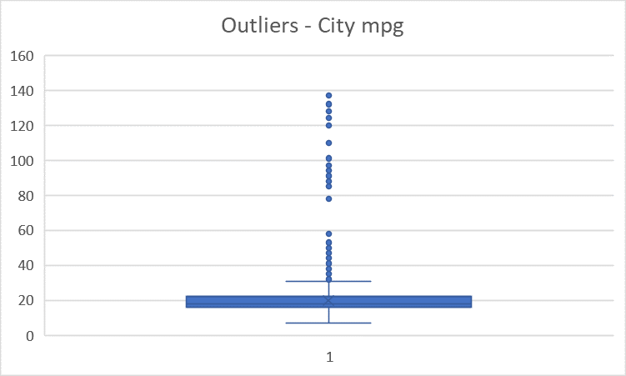
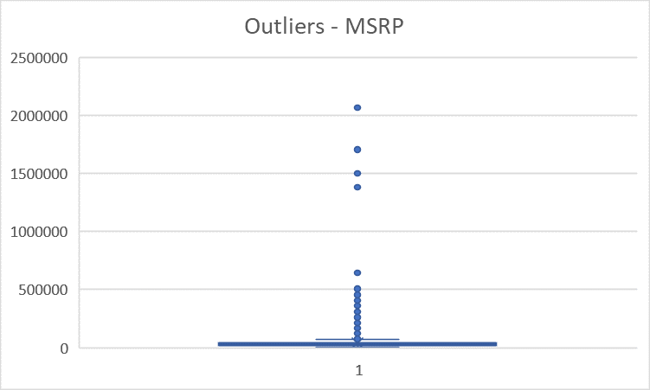
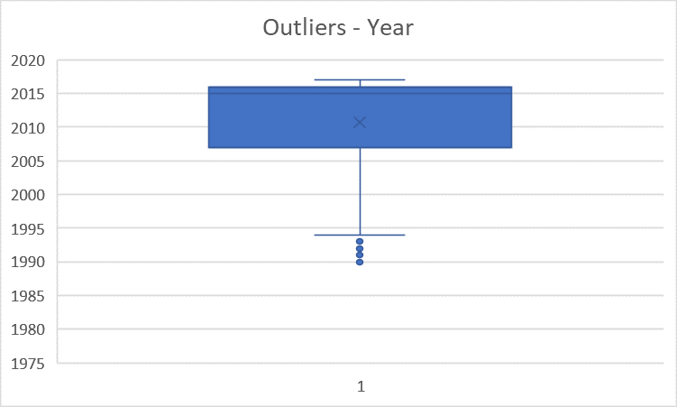
Outliers for every numeric columns were detected using Box plot.

Slide 12
DATA CLEANING
Handling Blank / NULL values : The missing values were handled using MODE and MEDIAN Imputation.
Duplicate records : The 715 records which were detected as duplicates were removed.
Handling Outliers : The outlier in Highway MPG which was at extreme end as it was a petrol car with MPG as 354 which is not possible. This was replaced with correct value after manual check on Internet. Other outliers were retained as such.
Therefore, the remaining number of records for Analysis : 11,199

Slide 13
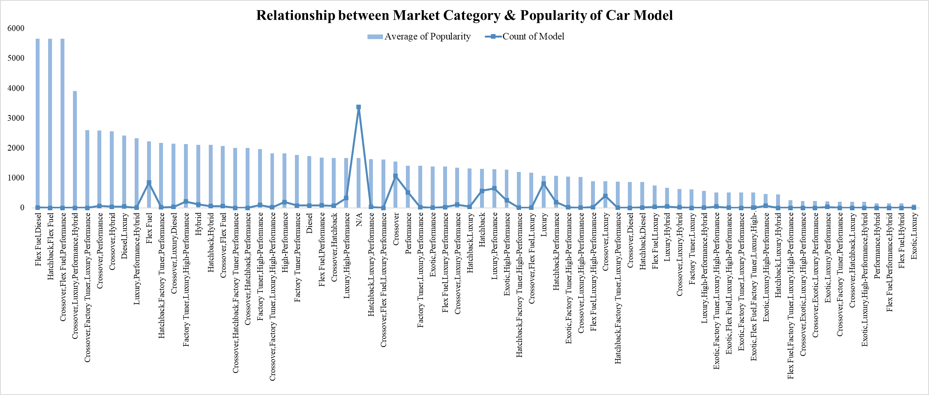
TASK 1
How does the popularity of a car model vary across different market categories?
Crossovers are the highest selling cars followed by Flex Fuel and Luxury. Highest average popularity is topped by ‘Flex Fuel, Diesel’, ‘Hatchback, Flex Fuel’ and ‘Crossover, Flex Fuel, Performance’.

Slide 14
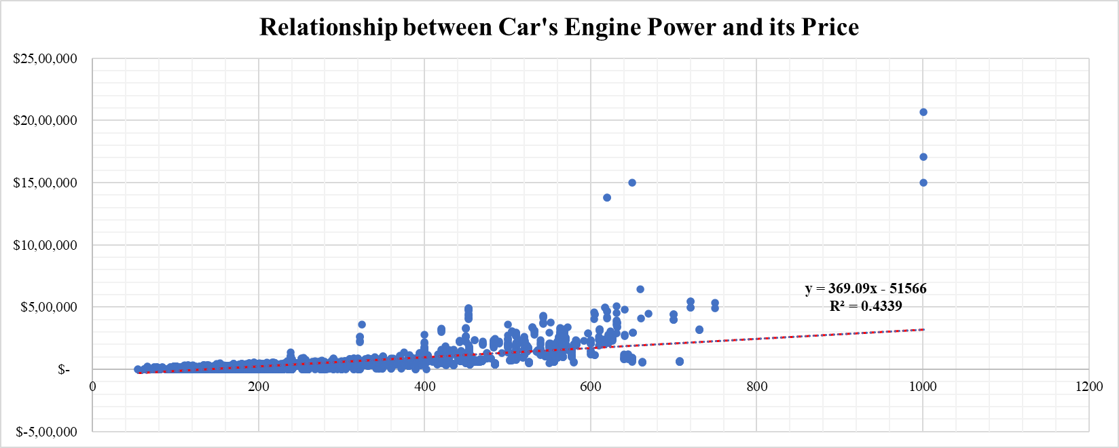
TASK 2
What is the relationship between a car's engine power and its price?
Car’s Engine Power and it’s Price follows a positive linear relation indicating that as the Horse power increases the price of the car also increases.

Slide 15
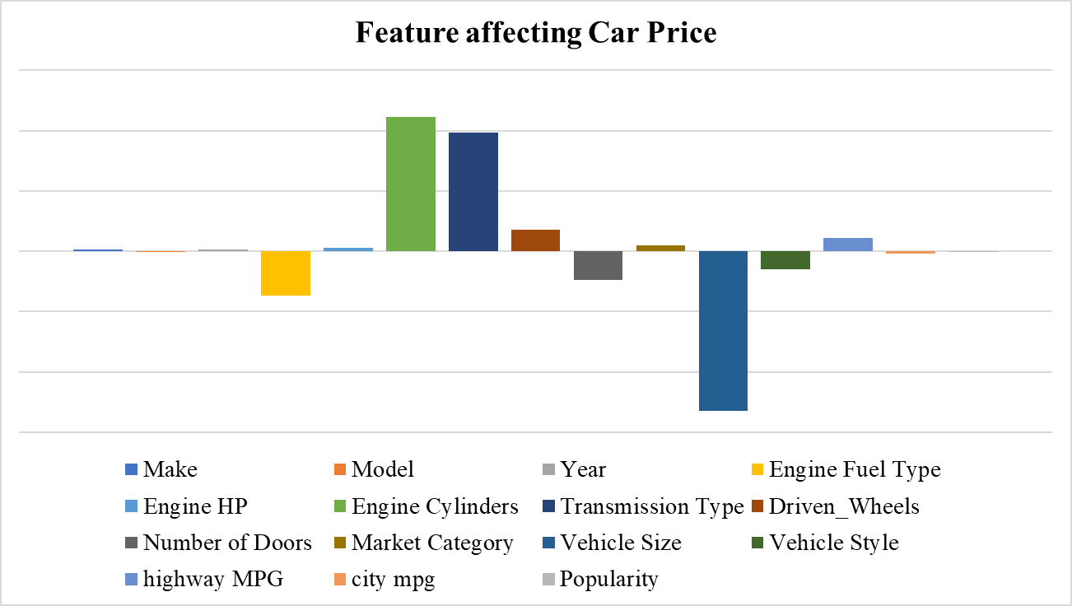
TASK 3
Which car features are most important in determining a car's price?
Feature’s that positively affect the Car Price : Engine Cylinder & Transmission Type
Feature’s that negatively affect the Car price : Vehicle size, Engine Fuel Type, Number of doors.

Slide 16
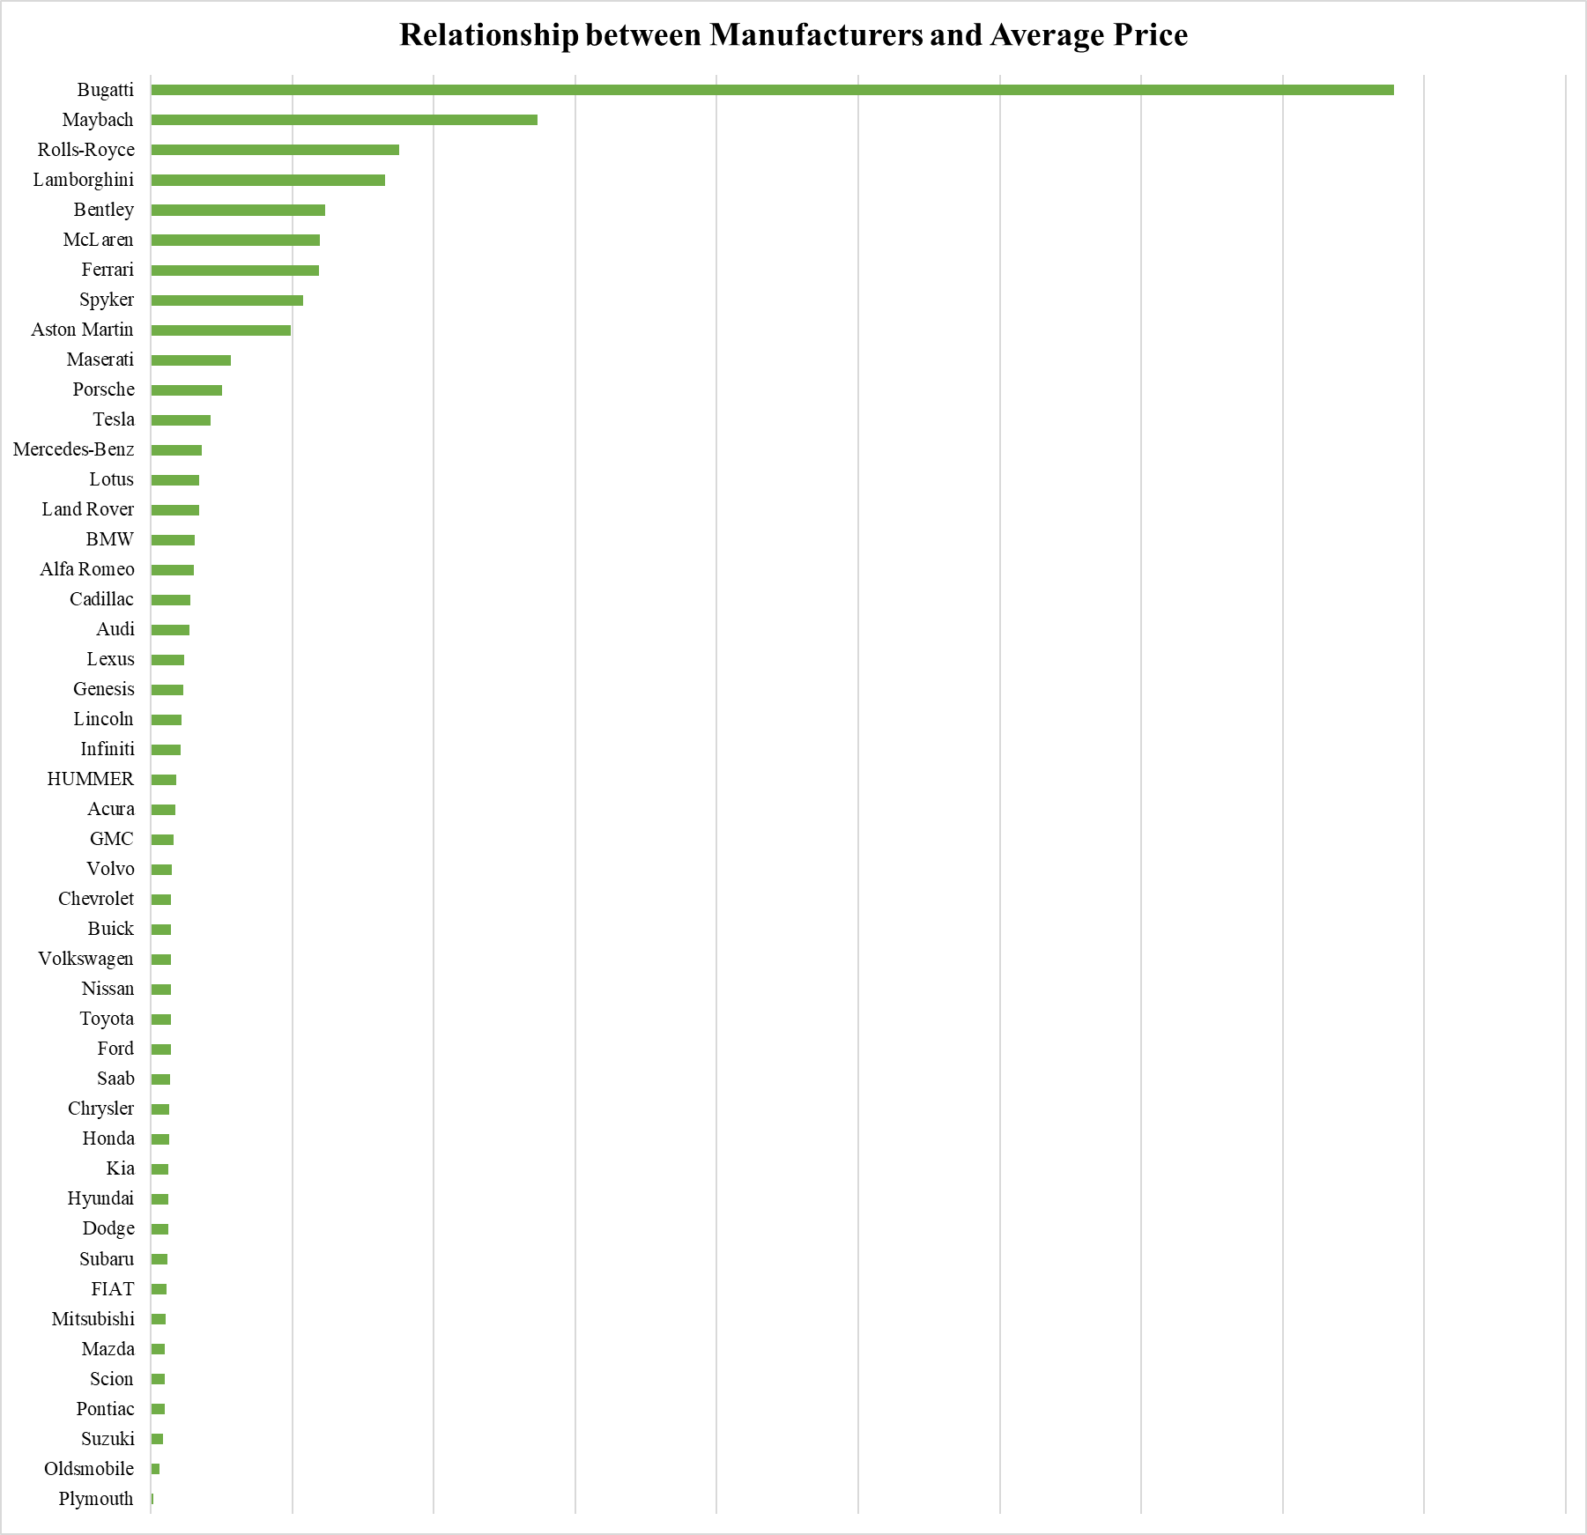
TASK 4
How does the average price of a car vary across different manufacturers?
Bugatti, Maybach, Rolls-Royce, Lamborghini has the highest average price whereas Plymouth, Oldsmobile, Suzuki has the least average price.

Slide 17
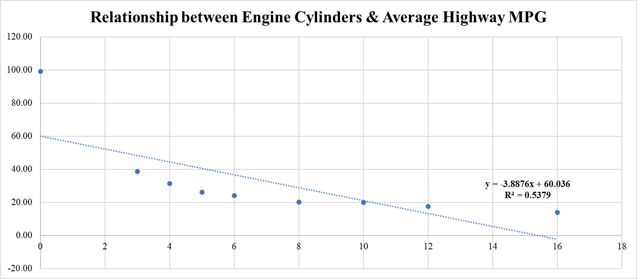
TASK 5
What is the relationship between fuel efficiency and the number of cylinders in a car's engine?
Engine Cylinders and Average Highway MPG follows a negative trendline indicating that as the number of Engine cylinders increases the average highway MPG decreases.

Slide 18
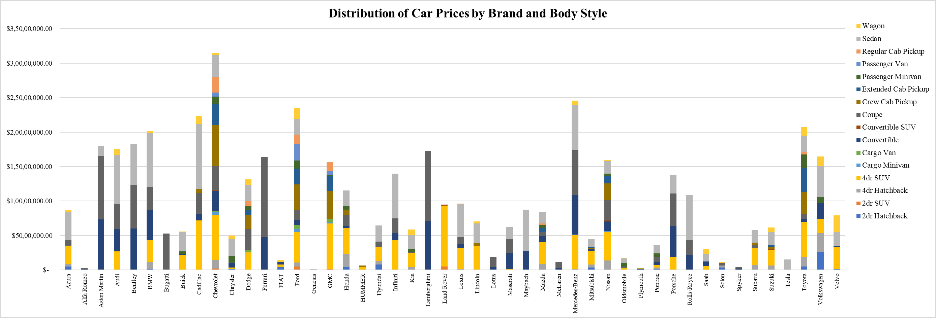
DASHBOARD TASK 1
How does the distribution of car prices vary by brand and body style?
Chevrolet make with the vehicle style 4dr SUV contribute more to the Car Price while Genesis contribute less to the Car Price.

Slide 19
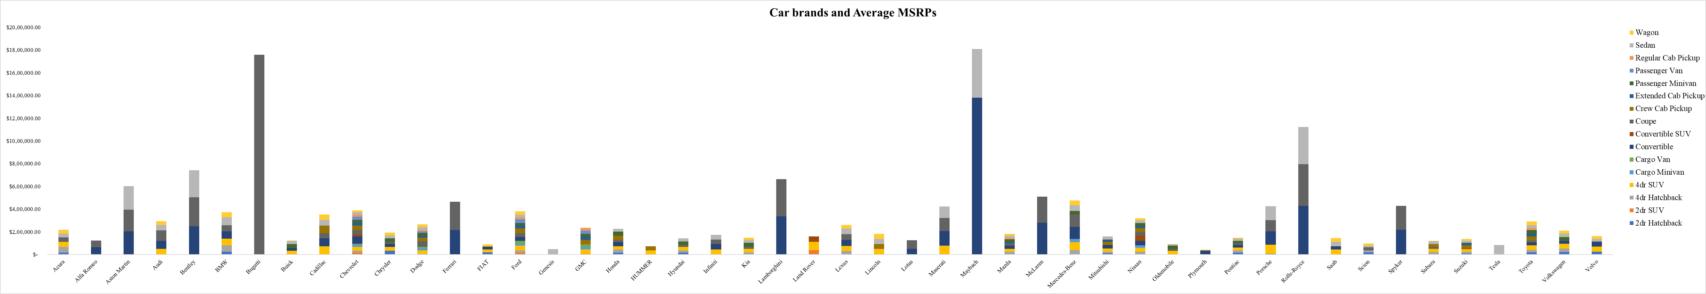
DASHBOARD TASK 2
Which car brands have the highest and lowest average MSRPs, and how does this vary by body style?
Bugatti make with the vehicle style Coupe has the Highest average MSRPs while Plymouth has the lowest average MSRPs.

Slide 20
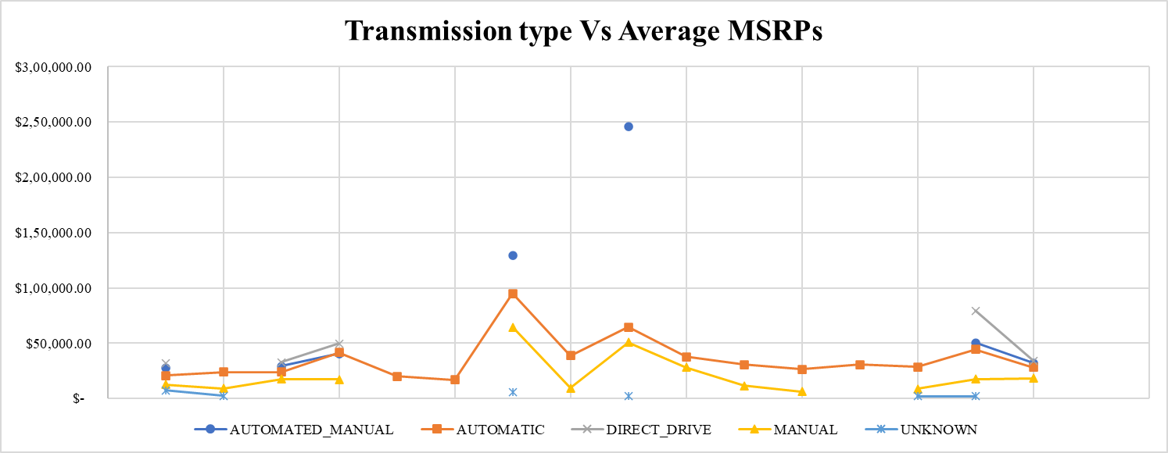
DASHBOARD TASK 3
How do the different feature such as transmission type affect the MSRP, and how does this vary by body style?
Automatic and Manual Transmission type are contributing more to the Average MSRPs.

Slide 21
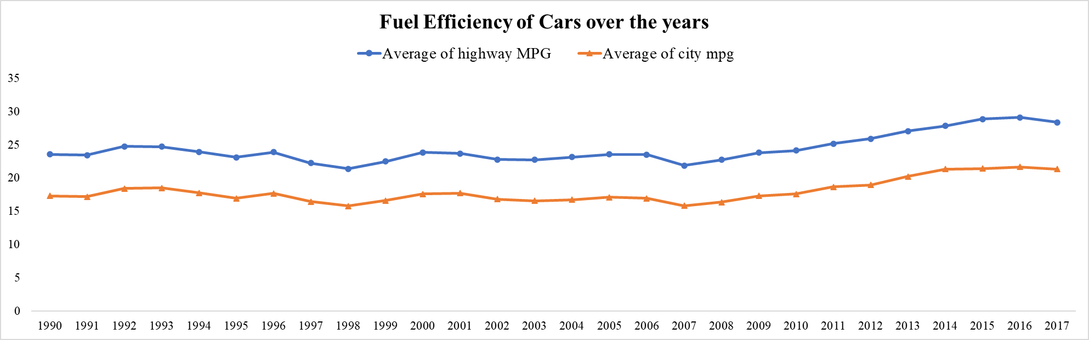
DASHBOARD TASK 4
How does the fuel efficiency of cars vary across different body styles and model years?

Slide 22
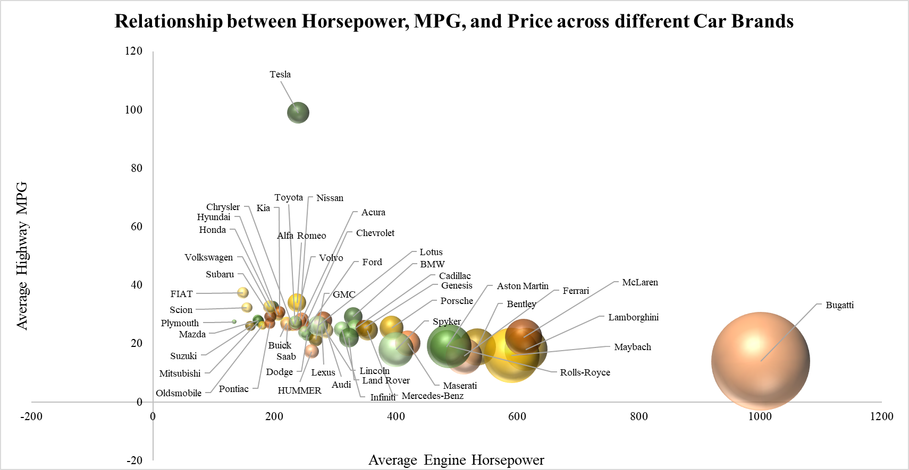
DASHBOARD TASK 5
How does the car's horsepower, MPG, and price vary across different Brands?

Slide 23
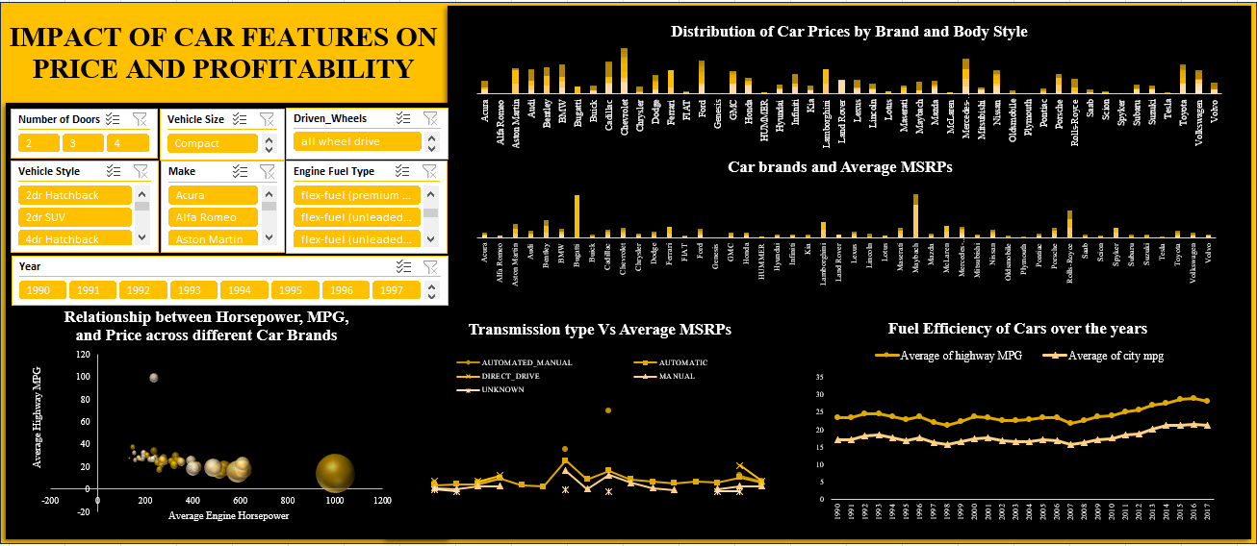
DASHBOARD

Slide 24
RESULT
This project emphasizes the importance of data analytics in making informed decisions within in the automotive industry. The insights gained from analyzing tasks such as exploring trends in car features and pricing over time, comparing the fuel efficiency of different types of cars, investigating the relationship between a car's features and its popularity, predicting the price of a car based on its features and market category will help the industry in taking inform decisions related to product development, marketing, and pricing.
Excel File Link : Click Here

Slide 25
THANK YOU

